Slide 1

SMT KASHIBAI NAVALE COLLEGE OF ENGINEERING
PROJECT REVIEW 2
TOPIC NAME – DESIGN AND DEVELOPMENT OF SOLAR BASED PELTIER REFRIGERATION SYSTEM
NAME OF STUDENT PROJECT GUIDE
SHELKE DHANANJAY -B190361193 PROF. - R.R.YENARE
SHELKE MAYUR - B190361194
CHOUGULE NISHANT- B190360884
KOKANE TEJAS - B190361237

Slide 2
CONTENTS
ABSTRACT
INTRODUCTION
OBJECTIVE
SCOPE
METHODOLOGY
LITRATURE SURVEY
DESIGN
DESIGN CALCULATIONS
RESULT AND DISCUSSION
ADVANTAGES AND DISADVANTAGES
APPLICATION
CONCLUSION
REFRENCES

Slide 3
ABSTRACT
The Peltier Refrigerator is a mobile refrigerator that is powered using solar panels, fully collapsible to haul around anywhere, and completely weather resistant.
Perfect for picnics at the park to keep your food fresh, keeping your brew skies chilled while listening to crunchy tunes at a music festival, or maybe you just can't go 10 minutes without eating a cheeseburger, so you haul around an entire refrigerator to fulfill your appetite so that your meat doesn't go bad.
You can charge the Peltier Refrigerator before you go out and if the sun goes down or you run out of sunlight, the battery will kick in and continue cooling your food/beverages until the sun is back, and better yet you can leave it outside all year long as it is weatherproof.

Slide 4
INTRODUCTION
A fridge, a freezer, a solar-powered wonder child called the Peltier Refrigerator .
The Peltier Refrigerator is a portable, self-sustaining, solar-powered, collapsible refrigerator and freezer that can go anywhere.
You can charge the Peltier Refrigerator before you go out and if the sun goes down or you run out of sunlight, the battery will kick in and continue cooling your food/beverages until the sun is back, and better yet you can leave it outside all year long as it is weatherproof.
A developed model of commercial thermoelectric refrigerators with finned heat exchanger is established.
The TEC cooler will utilize the power from the PV (photo-voltaic) panels to charge the battery and use a power from battery to maintain the temperature in the cooler box.

Slide 5
OBJECTIVE
There are so many refrigerators available in market, but they have their own limitations due to which they are they are not beneficial for special purposes.
Our main objective in this project is to develop a low-cost portable solar powered refrigerator for special and small needs.
The design should be simple, and the size must be compact to carry.
It should be light weight in nature and does not require any external power source for operation other than solar.
It should be leaked proof and opened and closed by using powerful magnets for attending foldability.

Slide 6
SCOPE
Though refrigerator is working successfully to its full capacity, still there are many changes and improvements to be made so that it is more user-friendly and cultivated in nature. Some changes are as follows:
By increasing the number of Peltier modules and keeping the size of refrigerator unchanged and decrease the temperature inside the box.
Similar process can be used for heating purpose also , if we add the heating side of the refrigerator chamber inside system.
By increasing the volume of refrigerator, the capacity can be varied.
Efficiency can be increased by choosing better insulation material.
The use of this refrigerator can also implement in Four-Wheeler by installing it at the time of manufacturing of vehicle

Slide 7
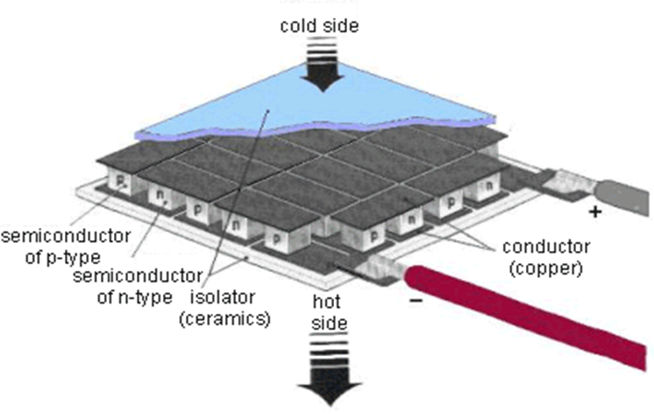
METHODOLOGY
A typical thermoelectric module is composed of two ceramic substrates that serve as a foundation and electrical insulation for P-type and N-type Bismuth Telluride dice that are connected electrically in series and thermally in parallel between the ceramics.
The current treats the P-type material as a hot junction needing to be cooled and the N-type as a cold junction needing to be heated. Since the material is at the same temperature, the result is that the hot side becomes hotter while the cold side becomes colder. The direction of the current will determine if a particular die cools down or heat up. In short, reversing the polarity will switch the hot and cold sides.

Slide 8
METHODOLOGY
It is an equipment, which work on principle of conversion of solar energy into electrical energy. A solar cell is used to develop 14 V- & 0.71-amps current DC supply and 10 W.
This electrical energy is stored in a battery which is of 12 volts DC supply which then supplies the power to transformer.
The fan work as heat extractor, it removes heat from system and add to heat sink. During operation, DC current flows through the TEM causing heat to be transferred from one side of the TEC to the other, creating a cold and hot side.

Slide 9
LITRATURE SURVEY
Jatin Patel, M. P. (2016). Improvement in the COP of Thermoelectric Cooler. This study experimentally investigates the performance of the single-stage and multistage TEC air-cooling module. It is quite easy to achieve a significant temperature difference in the single-stage TE module, but the COP of the single-stage module is very less for domestic use. In the multistage TE module, It is possible to get the required COP as well as better thermal performance.
Kshitij Rokde.Mitali Patle, T. k. (2017). Peltier Based Eco-Friendly Smart Refrigerator for Rural Areas. The efficiency of the refrigerator can be increased by increasing the number of Peltier plate modules which will eventually help in decreasing the temperature in less time. The number of Peltier plate modules used can be calculated using the heat transfer formula.
V.rajangam, m. (2015). Design and cfd analysis of thermoelectric cooling system. The design parameters involved a thermoelectric cooling system. Experimental work is carried out to obtain a temperature up to 5 degrees Celsius. An attempt was made in validating the experimental work with the CFD analysis by giving sufficient boundary conditions. Further, this work could be enhanced with different thermoelectric materials to attain high performance.

Slide 10
Awasti, M., & Mali, K. (2012). Design and Development of Thermoelectric Refrigerator. International Journal of Mechanical Engineering and Robotics Research (Volume No. 3). The retention time achieved was 52 min with the designed module in this project. To achieve a higher retention time, another alternative was incorporated. This consists of the additional heater on a heat sink.
Chetan Jangonda, K. P. (2016). Review of various Applications of Thermoelectric Module. Thermoelectric cooling added a new dimension to cooling. It has a major impact on a conventional cooling system. It is compact in size, no frictional elements are present, no coolant is required and the weight of the system is low. D.
Suman, p. H. (2020). Design and fabrication of thermoelectric refrigerator using peltier module. The efficiency and life of the Peltier refrigerator are maximized by using these water pockets and the temperature was controllable by changing the input voltage and current so we can maintain the things at the required temperature. Finally, it has been recorded the minimum temperature i.e., 2°c.

Slide 11
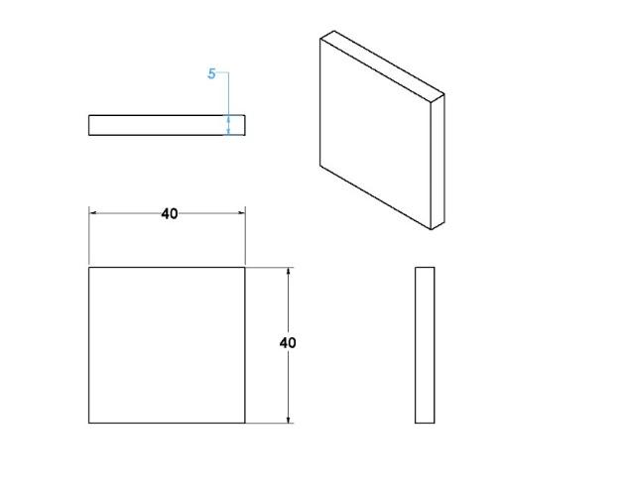
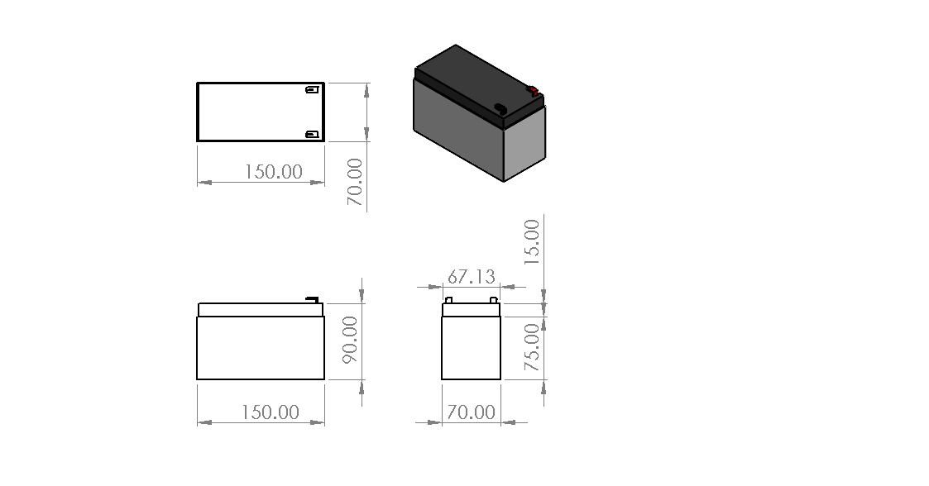
DESIGN
PELTIER MODULE
BATTERY

Slide 12
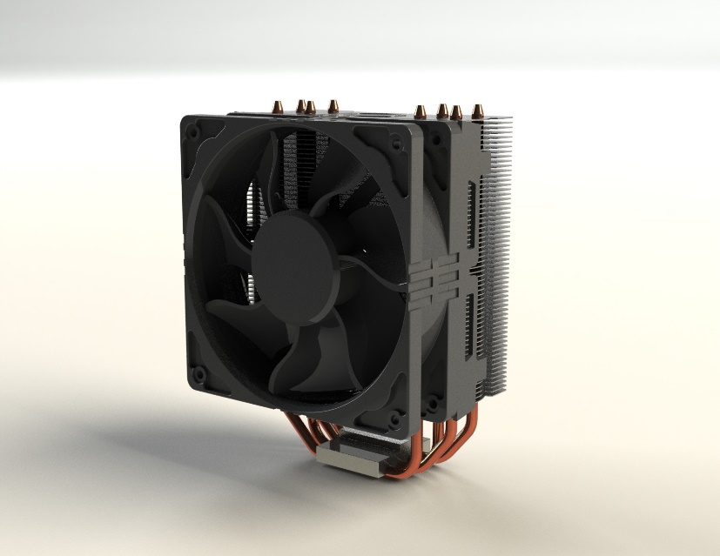
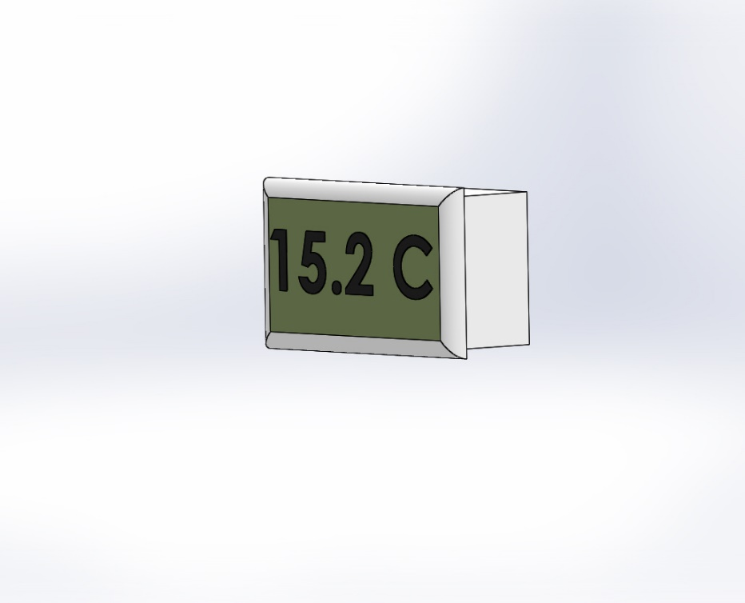
DESIGN
HEAT SINK
TEMPERATURE SENSOR

Slide 13
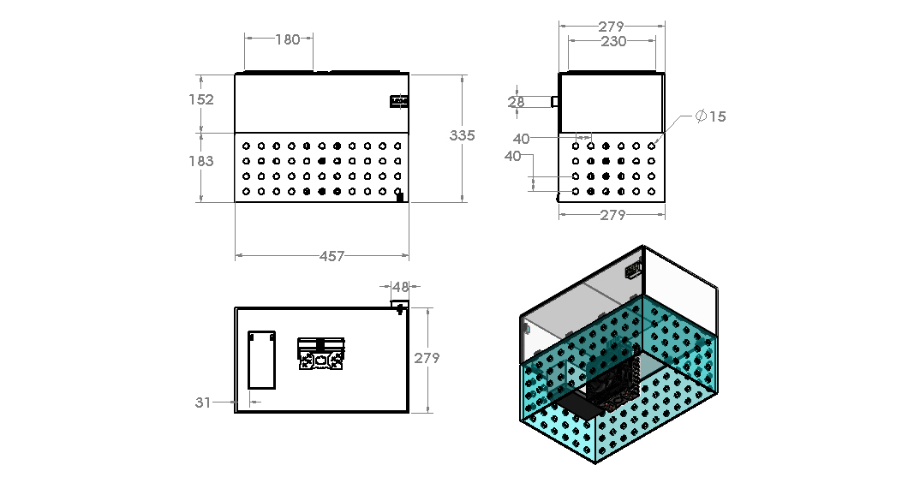
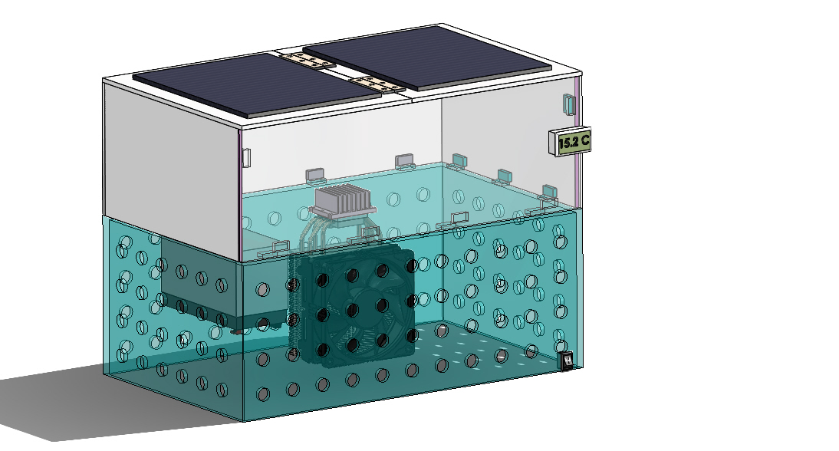
DESIGN
DRAFTING
ISOMETRIC VIEW

Slide 14
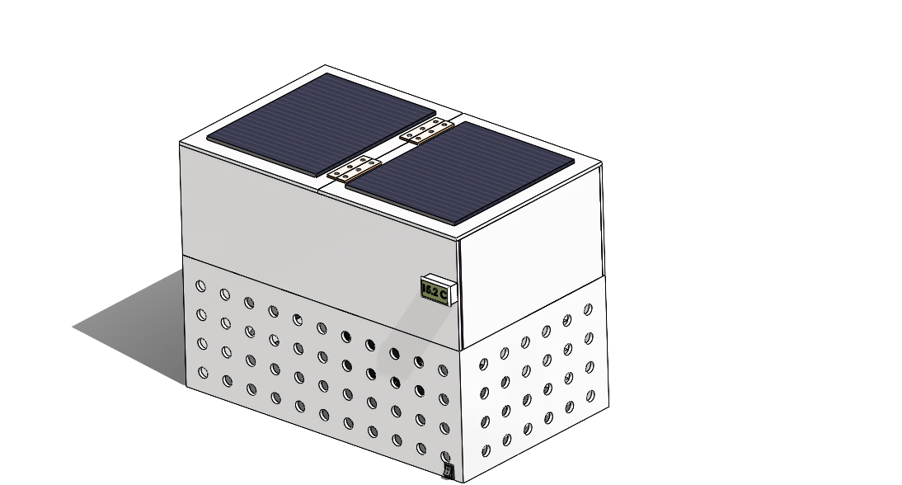
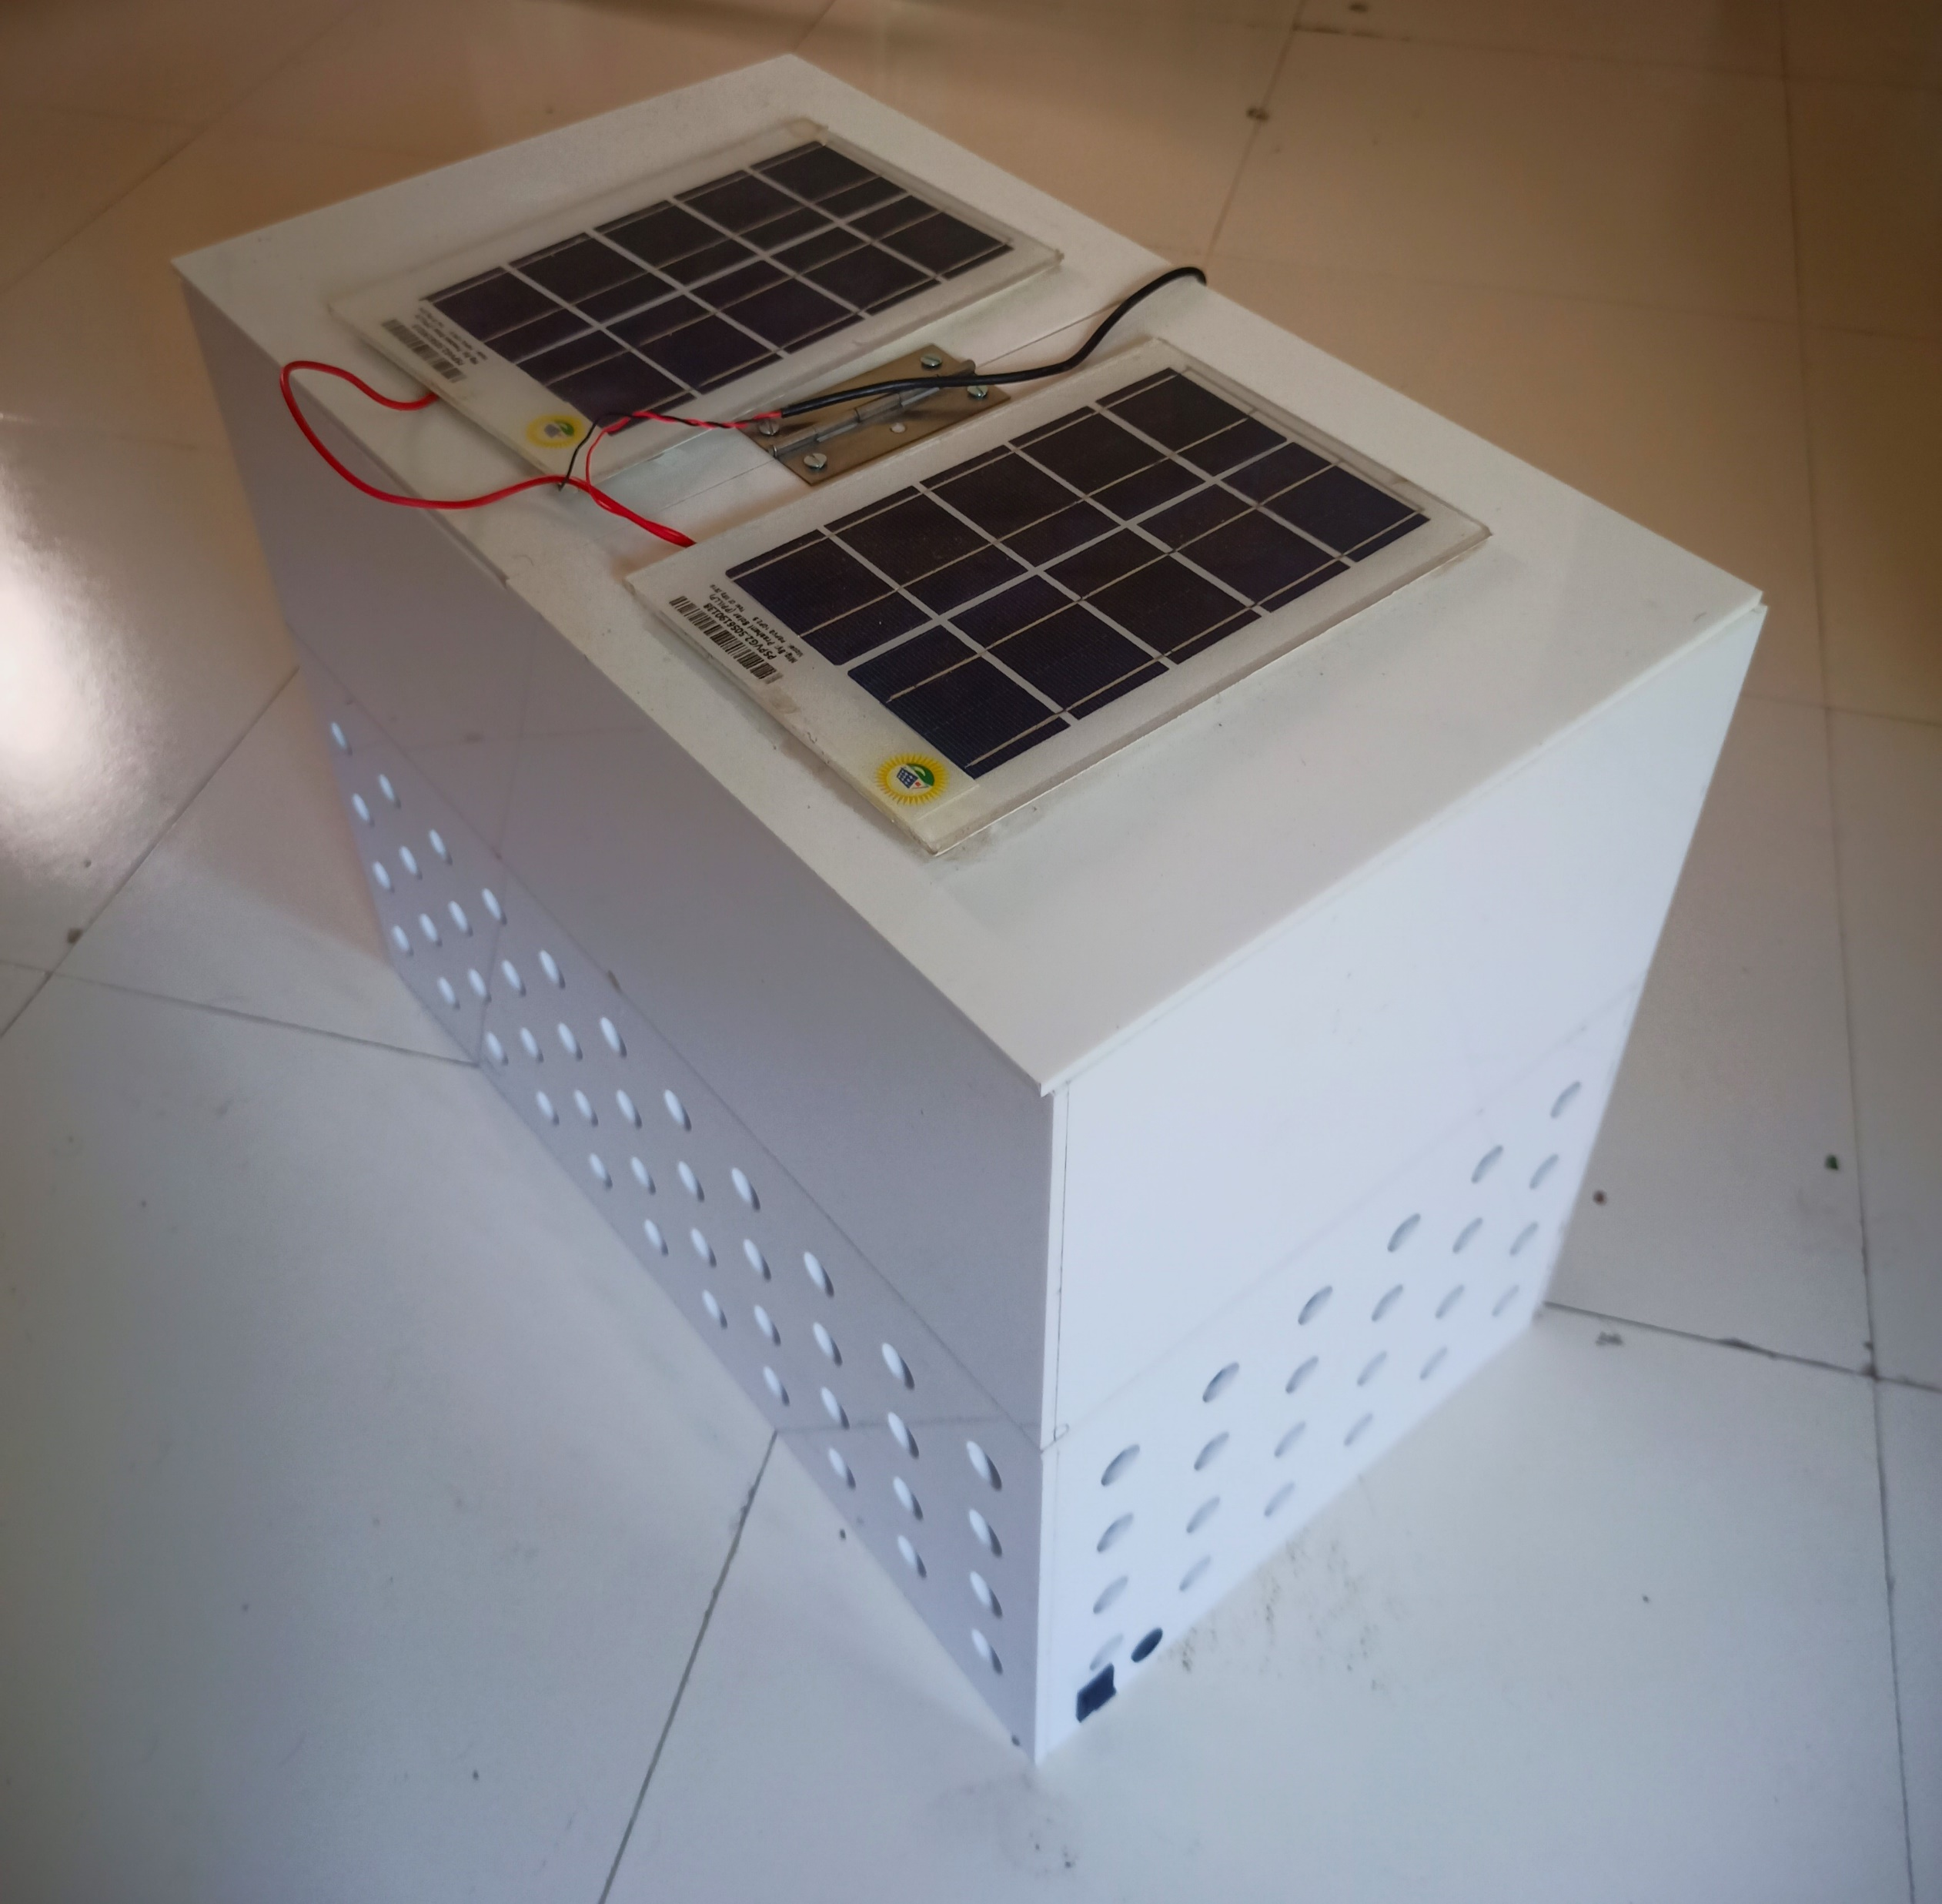
DESIGN
FINAL ASSEMBLY

Slide 15
DESIGN CALCULATIONS
In this we calculate two types of load Heat absorbing load in the cabin and Heat rejection load through the outside Heat sink fan.
Volume = 450×150×275 = 18562500 millimeters3 = 18 Liter
First, we have to calculate how much amount of power is required to absorb the heat of an 18-liter size of volume box at 35°coutside Temperature. So, there is a heat-absorbing load formula Q = m*Cp*(Th- Tc). so, we have to calculate Mass.
The amount of heat gained or lost by a sample (q) can be calculated using the equation q = mcΔT, where m is the mass of the sample, c is the specific heat, and ΔT is the temperature change
Mass = Density * volume = 1000*0.018 = 18 kg
Q = m*Cp*(Tamb -Tc) = 18 x 4.186 (35 -15) = 1506.96 kJ = 418 watt-hr or for 5 hr 418/5 = 83.6 watt
So, we required a total 83-watt heat-absorbing load in an 18 cubic meter volume box to reach 11°c in 83 watts we select 2 Peltier each Peltier would take 40 watts of load to cool up to 11°c.

Slide 16
BILL OF MATERIAL
SR.NO. | NAME OF THE COMPONENT | MATERIAL | QTY | COST
1 | BODY | ACRALYC | 1 | 2500
2 | MAGNET | NDFEB | 20 | 900
3 | PELTIER MODULE | SI BE | 1 | 700
4 | SOLAR PANNEL | POLY CRYSTALLINE 6 WATT | 2 | 600
5 | TEMPERATURE INDICATOR | STD TEMP -5 TO 70 DEGREE | 1 | 500
6 | BATTERY | STD 12 V DC | 1 | 2000
7 | HEAT PIPE COOLING MODULE | STD | 1 | 3500

Slide 17
BILL OF MATERIAL
8 | CHARGING SOCKET | STD | 1 | 20
9 | SWITCH | STD | 1 | 75
10 | NUT BOLT | STD | 1 | 10
11 | HEAT SINK | AL | 1 | 310
12 | BATTERY CHARGER | STD | 1 | 350
13 | WIRES | CU | 3 M | 80
14 | ADHESIVE | STD | 1 | 50
15 | SOLAR CHARGER | STD | 1 | 750
 | TOTAL |  |  | 12345

Slide 18
RESULTS AND DISCUSSION
Sr No. | Time (min) | Cold temperature (⁰C)
1 | 0 | 36
2 | 1 | ²⁵
3 | 1.5 | ²¹
4 | 2 | ¹⁸
5 | 2.5 | 17
6 | 3 | 15
7 | 4 | 14
8 | 5 | 13
9 | 6 | 11.5
10 | 7 | 10.5

Slide 19
ADVANTAGES
Light weight and compact for very small heat loads.
No CFC gases or refrigerant are used for cooling.
No moving parts, eliminating vibration, noise, and problems of wear.
Operates in any orientation.
Not affected by gravity or vibration.
Very low-cost device for cooling in small appliances.
Precision temperature control capability.
It can be used in drought affected areas.
Solar operation makes it more economical and environment friendly.

Slide 20
DISADVANTAGES
Limited to very small refrigeration loads due to size compaction.
Not suitable for higher refrigeration use due to poor efficiency.
Thermo-electric modules become very heavy and bulky as the refrigeration capacity increases.
The technology is normally used only to cool small surfaces (for example a processor in a computer) since there have been complications when making the system bigger.

Slide 21
APPLICATIONS
Medical field and ambulance- Pharmaceutical industry.
In Military, rural area, etc.
Dairy (milk) industry.
5. Scientific and research Laboratory.
Restaurant and hotel.
Vegetable, fish, fruit, beverage storage. Etc.

Slide 22
CONCLUSION
The lowest temperature reached to 10.5°C for the cooling while the highest temperature was obtained at 65°C for heating.
Using solar based refrigerator as an alternative of using compressor operated refrigerator has many benefits such as saving the environment, cost, and health.
The thermoelectric effect devices used as heat pumps, coolers, thermal energy sensors.
The major challenge faced in Thermoelectric cooling is the lower coefficient of performance, exclusively in large capacity systems.
Study different thermoelectric materials are essential to enhance the thermoelectric cooler coefficient of performance.

Slide 23
REFERENCE
[1] Rao, R. V., & Patel, V. (2013). “Multi-objective optimization of two stage thermoelectric cooler using a modified teaching–learning-based optimization algorithm.” Engineering Applications of Artificial Intelligence, 26(1), 430-445.
[2] Rawat, M. K., Chattopadhyay, H., & Neogi, S. (2013). “A review on developments of thermoelectric refrigeration and air conditioning systems: a novel potential green refrigeration and air conditioning technology.” International Journal of Emerging Technology and Advanced Engineering, 3(3), 362-367.
[3] Lee, H. (2013). “Optimal design of thermoelectric devices with dimensional analysis.” Applied energy, 106, 79-88.
[4] Pérez–Aparicio, J. L., Palma, R., & Taylor, R. L. (2012). “Finite element analysis and material sensitivity of Peltier thermoelectric cells coolers.” International Journal of Heat and Mass Transfer, 55(4), 1363-1374.
[5] Du, C. Y., & Wen, C. D. (2011). “Experimental investigation and numerical analysis for one-stage thermoelectric cooler considering Thomson effect.” International Journal of Heat and Mass Transfer, 54(23-24), 4875-4884.
[6] Riffat, S. B., & Ma, X. (2003). “Thermoelectrics: a review of present and potential applications.” Applied thermal engineering, 23(8), 913-935.
[7] Xi, H., Luo, L., & Fraisse, G. (2007). “Development and applications of solar-based thermoelectric technologies.” Renewable and Sustainable Energy Reviews, 11(5), 923-936.
[8] Bansal PK, Martin A, “Comparative Study of Vapour Compression, Thermoelectric and Absorption Refrigerator” – Rs. Int J Energy Res 2000; 24 (2): 93- 107.

Slide 24
THANK YOU

